Slide 1
Data Structures and algorithms GRAPH DATA STRUCTURE

Slide 2
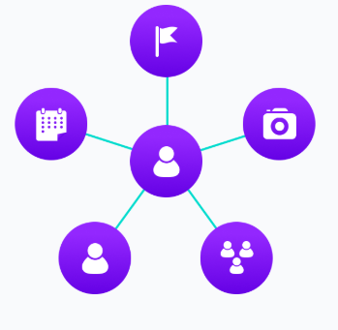
GRAPH – DATA STRUCTURE
A graph is a pictorial representation of a set of objects where some pairs of objects are connected by links. The interconnected objects are represented by points termed as vertices, and the links that connect the vertices are called edges. A graph data structure is a collection of nodes that have data and are connected to other nodes.
Let's try to understand this through an example. On Facebook, everything is a node. That includes User, Photo, Album, Event, Group, Page, Comment, Story, Video, Link, Note...anything that has data is a node.
Every relationship is an edge from one node to another. Whether you post a photo, join a group, like a page, etc., a new edge is created for that relationship.

Slide 3
GRAPH – DATA STRUCTURE
A Graph is a non-linear data structure consisting of nodes and edges. The nodes are sometimes also referred to as vertices and the edges are lines or arcs that connect any two nodes in the graph.
A data structure that consists of a set of nodes (vertices) and a set of edges that relate the nodes to each other
The set of edges describes relationships among the vertices .
A graph G is defined as follows:
G=(V,E)
V(G): A collection of vertices V
E(G): A collection of edges E, represented as ordered pairs of vertices (u,v)

Slide 4
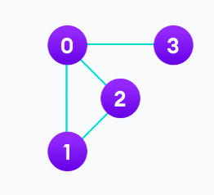
GRAPH – DATA STRUCTURE
EXAMPLE
In the graph,
V = {0, 1, 2, 3}
E = {(0,1), (0,2), (0,3), (1,2)}
G = {V, E}

Slide 5

1

Slide 6
GRAPH TERMINOLOGY – DATA STRUCTURE
Vertex: Each node of the graph is called a vertex. In the above graph, A, B, C, and D are the vertices of the graph.
Edge: The link or path between two vertices is called an edge. It connects two or more vertices. The different edges in the above graph are AB, BC, AD, and DC.
Adjacent node: In a graph, if two nodes are connected by an edge then they are called adjacent nodes or neighbors. In the above graph, vertices A and B are connected by edge AB. Thus A and B are adjacent nodes.
Degree of the node: The number of edges that are connected to a particular node is called the degree of the node. In the above graph, node A has a degree 2.

Slide 7
GRAPH TERMINOLOGY – DATA STRUCTURE
Path: The sequence of nodes that we need to follow when we have to travel from one vertex to another in a graph is called the path. In our example graph, if we need to go from node A to C, then the path would be A -> B -> C
Closed path: If the initial node is the same as a terminal node, then that path is termed as the closed path.
Simple path: A closed path in which all the other nodes are distinct is called a simple path.
Cycle: A path in which there are no repeated edges or vertices and the first and last vertices are the same is called a cycle. In the above graph, A->B->C->D->A is a cycle.

Slide 8
GRAPH TERMINOLOGY – DATA STRUCTURE
Connected Graph: A connected graph is the one in which there is a path between each of the vertices. This means that there is not a single vertex which is isolated or without a connecting edge. The graph shown above is a connected graph.
Complete Graph: A graph in which each node is connected to another is called the Complete graph. If N is the total number of nodes in a graph then the complete graph contains N(N-1)/2 number of edges.
Weighted Graph: A positive value assigned to each edge indicating its length (distance between the vertices connected by an edge) is called weight. The graph containing weighted edges is called a weighted graph. The weight of an edge e is denoted by w(e) and it indicates the cost of traversing an edge.
Diagraph: A digraph is a graph in which every edge is associated with a specific direction and the traversal can be done in specified direction only.

Slide 9
GRAPH TERMINOLOGY – DATA STRUCTURE
THINGS TO REMEMBER
Order of the graph = The number of vertices in the graph.
Size of the graph = The number of edges in the graph.
Degree of a vertex of a graph = Number of edges incident to the vertex.

Slide 10
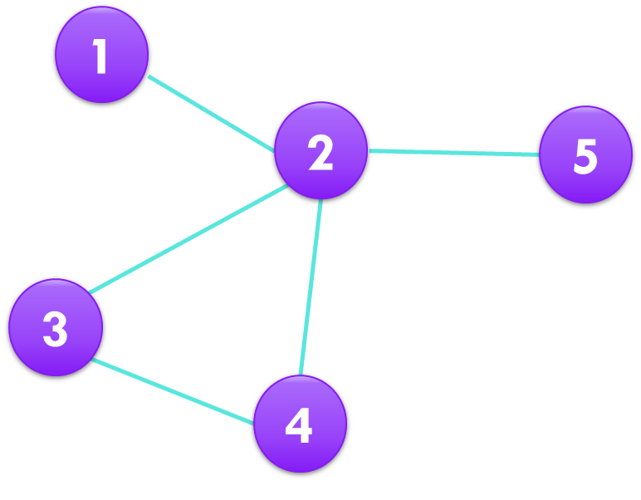
TYPES OF GRAPH – DATA STRUCTURE
Finite Graphs
A graph is said to be finite if it has finite number of vertices and finite number of edges.

Slide 11
TYPES OF GRAPH – DATA STRUCTURE
Infinite Graph
A graph is said to be infinite if it has infinite number of vertices as well as infinite number of edges.

Slide 12
TYPES OF GRAPH – DATA STRUCTURE
TRIVIAL Graph
A graph is said to be trivial if a finite graph contains only one vertex and no edge.
1

Slide 13
TYPES OF GRAPH – DATA STRUCTURE
Simple Graph
A simple graph is a graph which does not contains more than one edge between the pair of vertices. A simple railway tracks connecting different cities is an example of simple graph.
1
2
3
4
1
2
3
4

Slide 14
TYPES OF GRAPH – DATA STRUCTURE
Multi Graph
Any graph which contain some parallel edges but doesn’t contain any self-loop is called multi graph. For example A Road Map.
Parallel Edges: If two vertices are connected with more than one edge than such edges are called parallel edges that is many roots but one destination.
Loop: An edge of a graph which join a vertex to itself is called loop or a self-loop.
5
2
e6
e1
1
e2
e3
e5
e4
3
4

Slide 15
TYPES OF GRAPH – DATA STRUCTURE
NULL Graph
A graph of order n and size zero that is a graph which contain n number of vertices but do not contain any edge.
1
2
3
4

Slide 16
TYPES OF GRAPH – DATA STRUCTURE
1
Simple Graph
A simple graph with n vertices is called a complete graph if the degree of each vertex is n-1, that is, one vertex is attach with n-1 edges.
A complete graph is also called Full Graph.
2
3
1
2
4
5
3
4

Slide 17
TYPES OF GRAPH – DATA STRUCTURE
Pseudo Graph
A graph G with a self loop and some multiple edges is called pseudo graph.
1
2
3
4

Slide 18
TYPES OF GRAPH – DATA STRUCTURE
Regular Graph
A simple graph is said to be regular if all vertices of a graph G are of equal degree. All complete graphs are regular but vice versa is not possible.

Slide 19
TYPES OF GRAPH – DATA STRUCTURE
Labelled Graph
If the vertices and edges of a graph are labelled with name, data or weight then it is called labelled graph. It is also called Weighted Graph.
e1
e2
e3
e4

Slide 20
TYPES OF GRAPH – DATA STRUCTURE
Digraph GrapH
A graph G = (V, E) with a mapping f such that every edge maps onto some ordered pair of vertices (Vi, Vj) is called Digraph.
It is also called Directed Graph. Ordered pair (Vi, Vj) means an edge between Vi and Vj with an arrow directed from Vi to Vj. Here in the figure:
e1 = (V1, V2) e2 = (V2, V3) e4 = (V2, V4)
5
e5
4
e3
e6
e7
e4
3
e2
1
2
e1

Slide 21
TYPES OF GRAPH – DATA STRUCTURE
Subgraph
A graph G = (V1, E1) is called subgraph of a graph G(V, E) if V1(G) is a subset of V(G) and E1(G) is a subset of E(G) such that each edge of G1 has same end vertices as in G.
V5
e5
V4
e3
e7
e6
e4
V3
e2
V1
e1
V2

Slide 22
TYPES OF GRAPH – DATA STRUCTURE
Connected or Disconnected Graph
A graph G is said to be connected if for any pair of vertices (Vi, Vj) of a graph G are reachable from one another. Or a graph is said to be connected if there exist at least one path between each and every pair of vertices in graph G, otherwise it is disconnected. A null graph with n vertices is disconnected graph consisting of n components. Each component consist of one vertex and no edge.

Slide 23
GRAPH REPRESENTATION – DATA STRUCTURE
Graphs are commonly represented in two ways
Adjacency Matrix
An adjacency matrix is a 2D array of V x V vertices. Each row and column represent a vertex.
If the value of any element a[i][j] is 1, it represents that there is an edge connecting vertex i and vertex j.

Slide 24
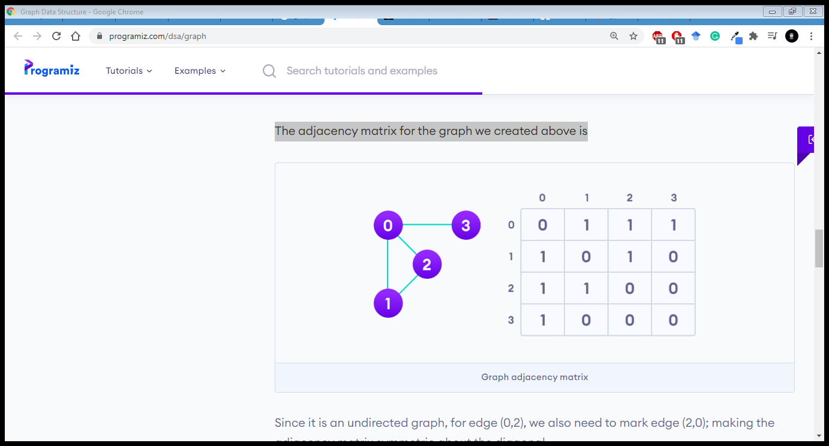
GRAPH REPRESENTATION – DATA STRUCTURE
The adjacency matrix for the graph we created above is :
Since it is an undirected graph, for edge (0,2), we also need to mark edge (2,0); making the adjacency matrix symmetric about the diagonal.
Edge lookup(checking if an edge exists between vertex A and vertex B) is extremely fast in adjacency matrix representation but we have to reserve space for every possible link between all vertices(V x V), so it requires more space.

Slide 25
GRAPH REPRESENTATION – DATA STRUCTURE
Pros: Representation is easier to implement and follow. Removing an edge takes O(1) time. Queries like whether there is an edge from vertex ‘u’ to vertex ‘v’ are efficient and can be done O(1).
Cons: Consumes more space O(V^2). Even if the graph is sparse(contains less number of edges), it consumes the same space. Adding a vertex is O(V^2) time.

Slide 26
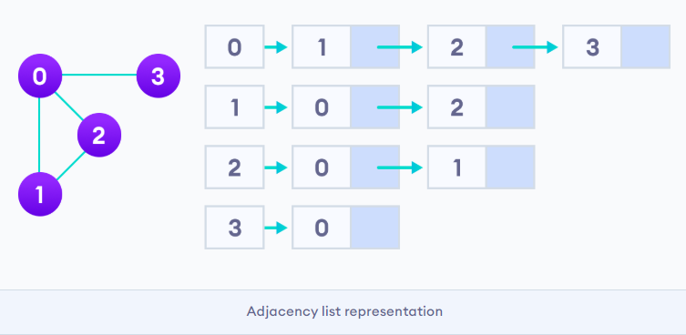
GRAPH REPRESENTATION – DATA STRUCTURE
Adjacency List
An adjacency list represents a graph as an array of linked lists.
The index of the array represents a vertex and each element in its linked list represents the other vertices that form an edge with the vertex.
The adjacency list for the graph we made in the first example is as follows:

Slide 27
GRAPH REPRESENTATION – DATA STRUCTURE
Pros: Saves space O(|V|+|E|) . In the worst case, there can be C(V, 2) number of edges in a graph thus consuming O(V^2) space. Adding a vertex is easier.
Cons: Queries like whether there is an edge from vertex u to vertex v are not efficient and can be done O(V).

Slide 28
GRAPH REPRESENTATION – DATA STRUCTURE
An adjacency list is efficient in terms of storage because we only need to store the values for the edges. For a graph with millions of vertices, this can mean a lot of saved space.
Graph Operations
The most common graph operations are:
Check if the element is present in the graph
Graph Traversal (BFS, DFS)
Add elements(vertex, edges) to graph
Finding the path from one vertex to another

Slide 29
GRAPH – DATA STRUCTURE
Application of Graphs
Computer Science: In computer science, graph is used to represent networks of communication, data organization, computational devices etc.
Physics and Chemistry: Graph theory is also used to study molecules in chemistry and physics.
Social Science: Graph theory is also widely used in sociology.
Mathematics: In this, graphs are useful in geometry and certain parts of topology such as knot theory.
Biology: Graph theory is useful in biology and conservation efforts.

